Slide 1
Salary Components Modeler
Allow employees to structure their own Salary Package

Slide 2
Overview
01
How do you maintain CTC changes
02
Typical Changes
03
Manage CTC changes the easy way
04
What else can this magical tool do
05
How does it work

Slide 3
Overview
06
How do the rules work
07
iEnabler process
08
Approval Process
09
Reports

Slide 4
How do you maintain CTC Changes
Call employee to fill in a manual request form
Receive Change request from personnel members
Validate request and then end existing fund code and create a new fund code for the new medical aid option
Notify employee that changes have been affected
Next payroll run will calculate the new medical aid fund code and value

Slide 5
Typical Changes
Bonus, Bonus month, Tax on Bonus
Pension
Medical Aid, fund or Dependants
Group Life

Slide 6
HR & Payroll Actions required
40%
1%
How do you handle the volume
Not a problem

Slide 7
Manage CTC changes the easy way
Approve/Reject submitted changes. Approved Changes are automatically created
Personnel Change or Manage their own data within a controlled environment
Create control
Determine Approval processes

Slide 8
What Else Can this Magical tool do
01
Convert Personnel to CTC
Personnel currently on Salary + Benefit salary packages can be converted to CTC Package
02
Control Changes on CTC
This will control what can be changed as well as when will it be come active.
03
Allow new Personnel to setup CTC packages
This will allow new personnel that is appointed to structure their own package

Slide 9
How Does this work
HR/Payroll create control records which controls Components that can be changed as well as when it will be activated – This applies for Changes, Conversion to TGP and New Personnel
Automatically create the correct information if approved
Detremine the approval process that is required
Generates pay slip with a before and after image, user may return and apply as many changes as possible until satisfied before submitting it for approval
Open the iEnabler for personnel to allow them to change what is allowed to be changed
Upload Documentation

Slide 10
How do the rules work
It allows HR to control per Appointment type, grade, Rank even age what will be allowed to be changed as well as to what it may be changed
It allows for global changes to include all ranks and grades
It allows HR to determine what the effective cycle for the changes will be
It is flexible and allows changes within ranges

Slide 11
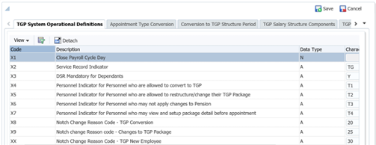
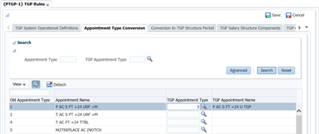
A quick look at some of the rules for conversion to CTC

Slide 12
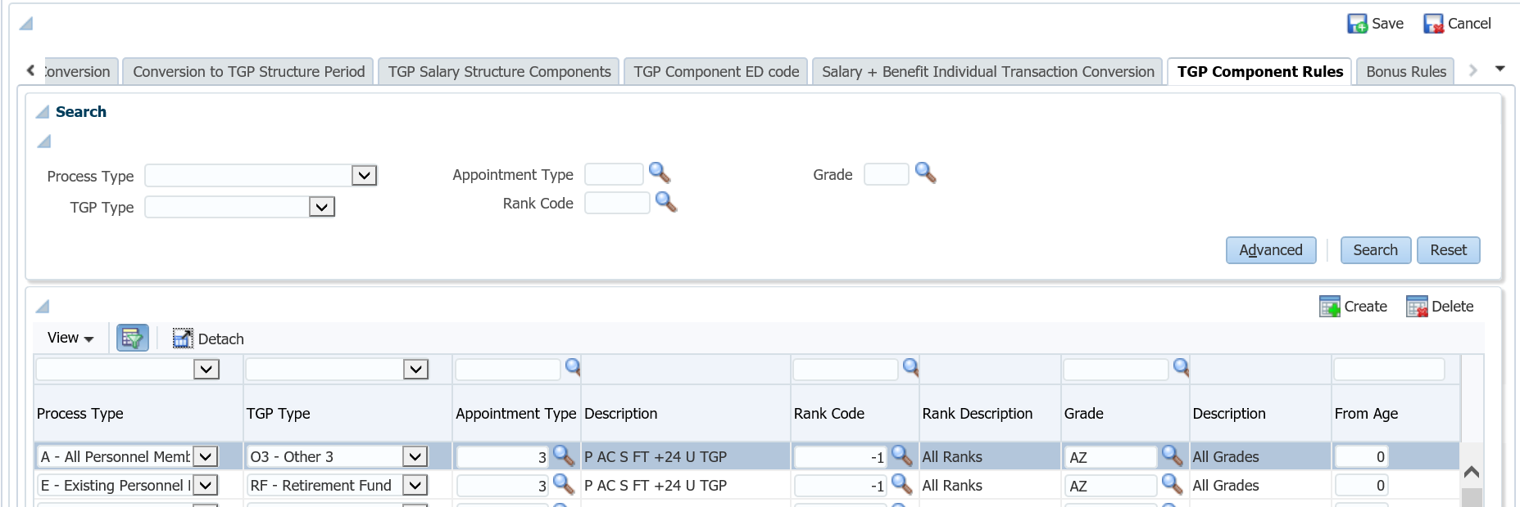
A quick look at the rules for changes to CTC and new employees

Slide 13
A quick look at the rules for Changes to CTC

Slide 14
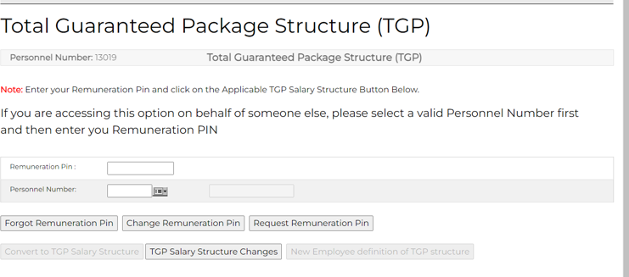
iEnabler process

Slide 15
Conversion to TGP

Slide 16
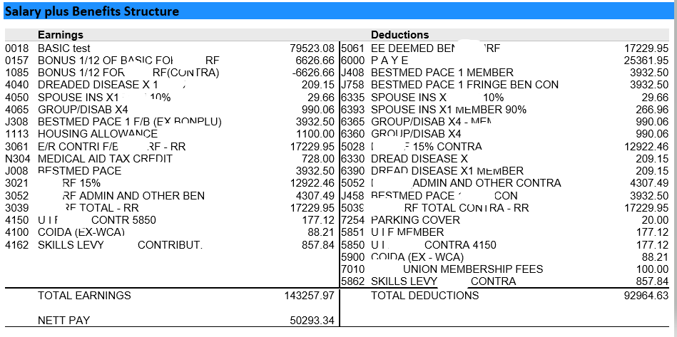
Conversion to TGP

Slide 17
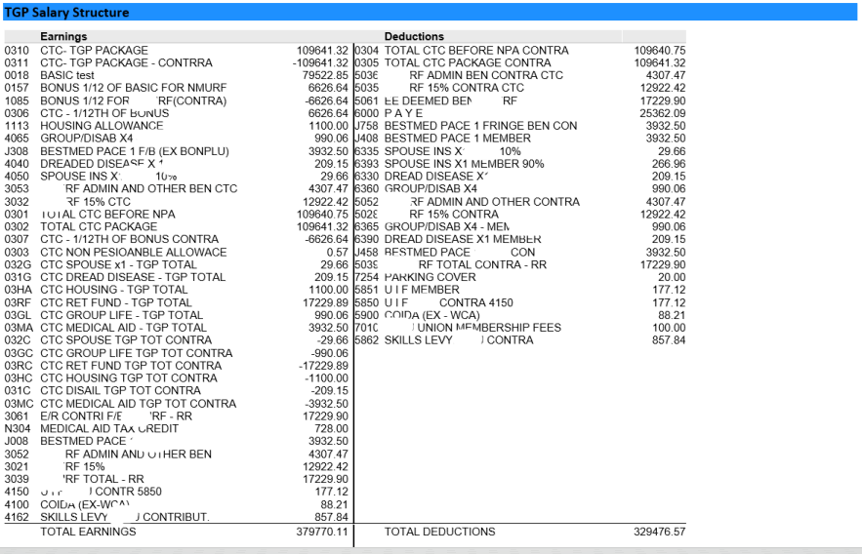
Conversion to TGP

Slide 18
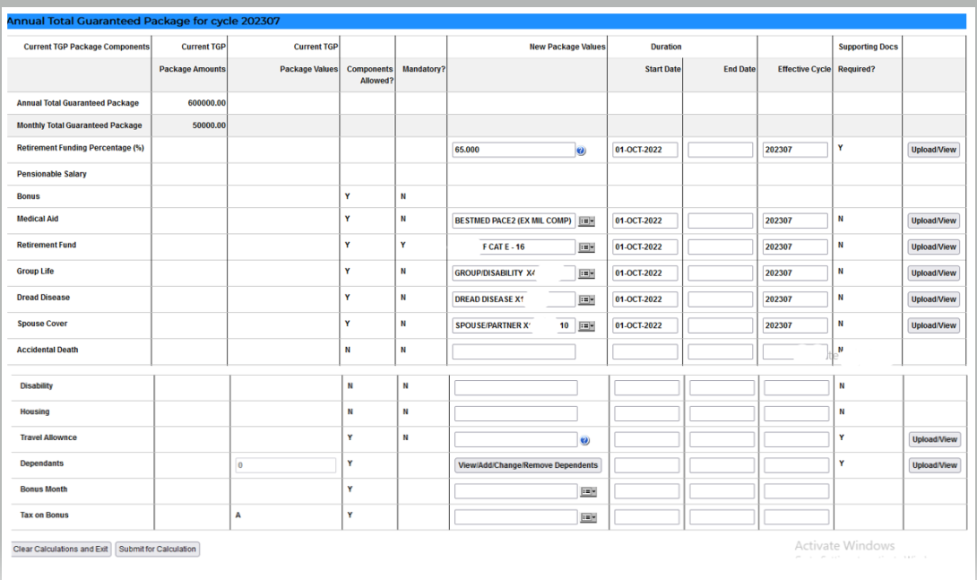
New Appointee setting up his own package

Slide 19
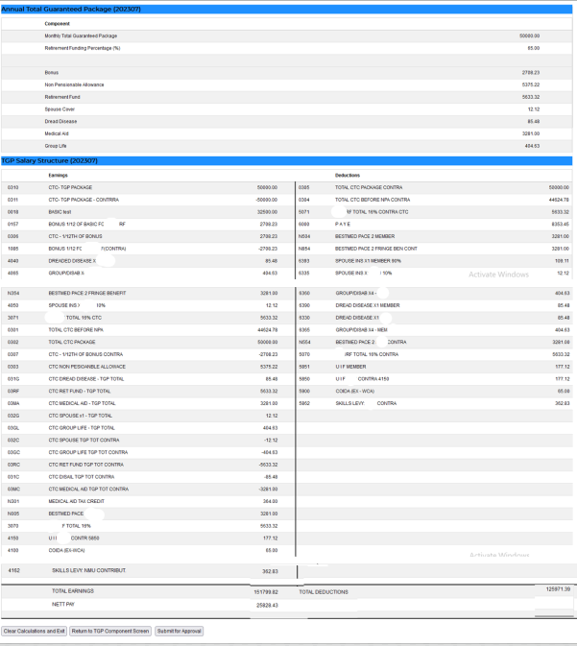
New Appointee setting up his own package

Slide 20
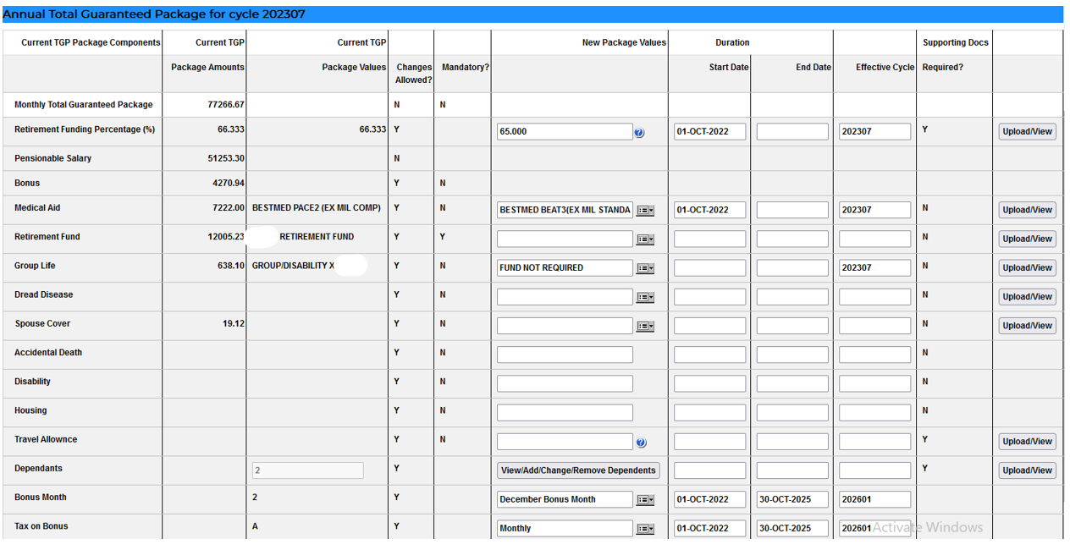
Changes to CTC Package by employee

Slide 21
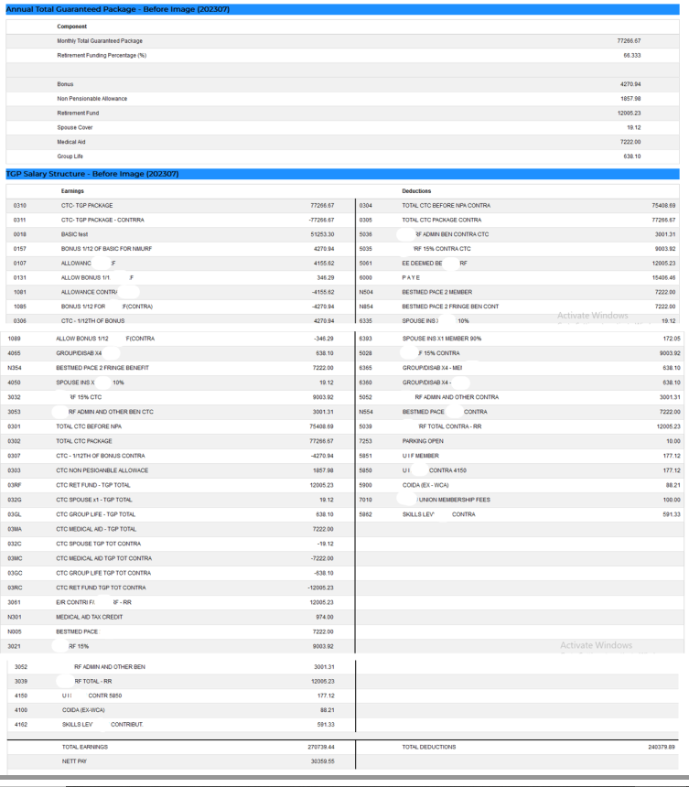
Changes to CTC Package by employee

Slide 22
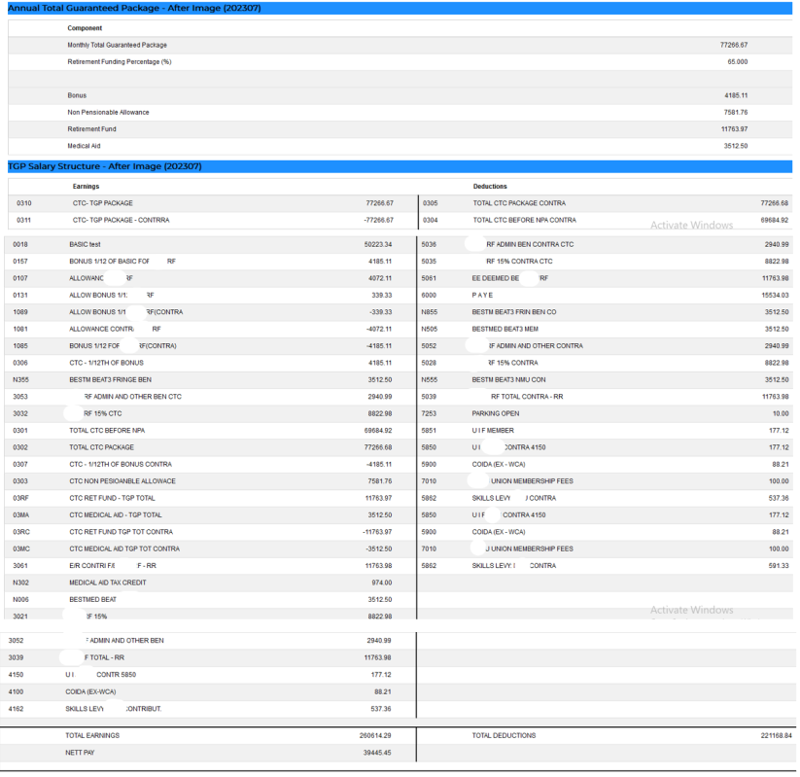
Changes to CTC Package by employee

Slide 23
Approval
Approval of Financial changes
The Approver will see the same before and after images the user saw when submitting the changes for approval.
In the case of conversion nothing is allowed to be changed, only conversion of existing detail is allowed.
Approval of Medical Aid Changes
In the case of changes to medical aid funds or dependants it will be approved by a separate approver.

Slide 24
Approval

Slide 25
Approval

Slide 26
Approval

Slide 27
New Appointee setting up his own package

Slide 28
Changes to CTC Package by employee

Slide 29
Changes to CTC Package by employee

Slide 30
Approval
Approval of Financial changes
The Approver will see the same before and after images the user saw when submitting the changes for approval.
In the case of conversion nothing is allowed to be changed, only conversion of existing detail is allowed.
Approval of Medical Aid Changes
In the case of changes to medical aid funds or dependants it will be approved by a separate approver.

Slide 31
Approval

Slide 32
Reports
Conversion to TGP/New Package Structure and Changes to TGP Packages {PTGPR-1}
This option provides the facility to generate a report that will display all relevant data regarding TGP data changes that resulted from the iEnabler for the following requests and will display changes requested as well as whether it was approved /not approved/Awaiting approval/copied to the back office or not and what type of request
Copy iEnabler TGP Conversions / Changes / New Employees to the Back Office {PTGPR-2}
This process is used to copy approved iEnabler TGP changes originating from existing employees converting from a Basic + Benefit Salary Structure to a TGP Structure, existing employees changes their package components or from new employees defining their TGP Structure, from a staging area into the back office, in order for them to become effective and active in the system.
This process may be linked to the scheduler to run daily/hourly etc. as required; it may also be run manually
Conversion to TGP Before and After Images {PTGPR-3}
The purpose of this report is to display the salary transactions before converting to a TGP Salary structure as well as after converting to a TGP Salary structure in order to reconcile the Salary + Benefit Salary structure with the TGP Salary structure to identify any salary transactions not converted correctly that may cause the conversion process to imbalance after the process has run

Slide 33
Are you Interested in reducing your Workload

Slide 34
Contact us we help you
Contact
Frans Pelser - Frans.Pelser@Adaptit.com
Allie de Nysschen – Allie.denysschen@Adaptit.com

Slide 36
Thank You

